Slide 1
Developing & Scaling the Food Sector
Orla Donohoe, Sector Manager, Bord Bia
10th September 2014

Slide 2

“To drive through market insight and in partnership with industry the commercial success of a world class Irish food, drink and horticulture industry”
Bord Bia Statement of Strategy 2012-14

Slide 3
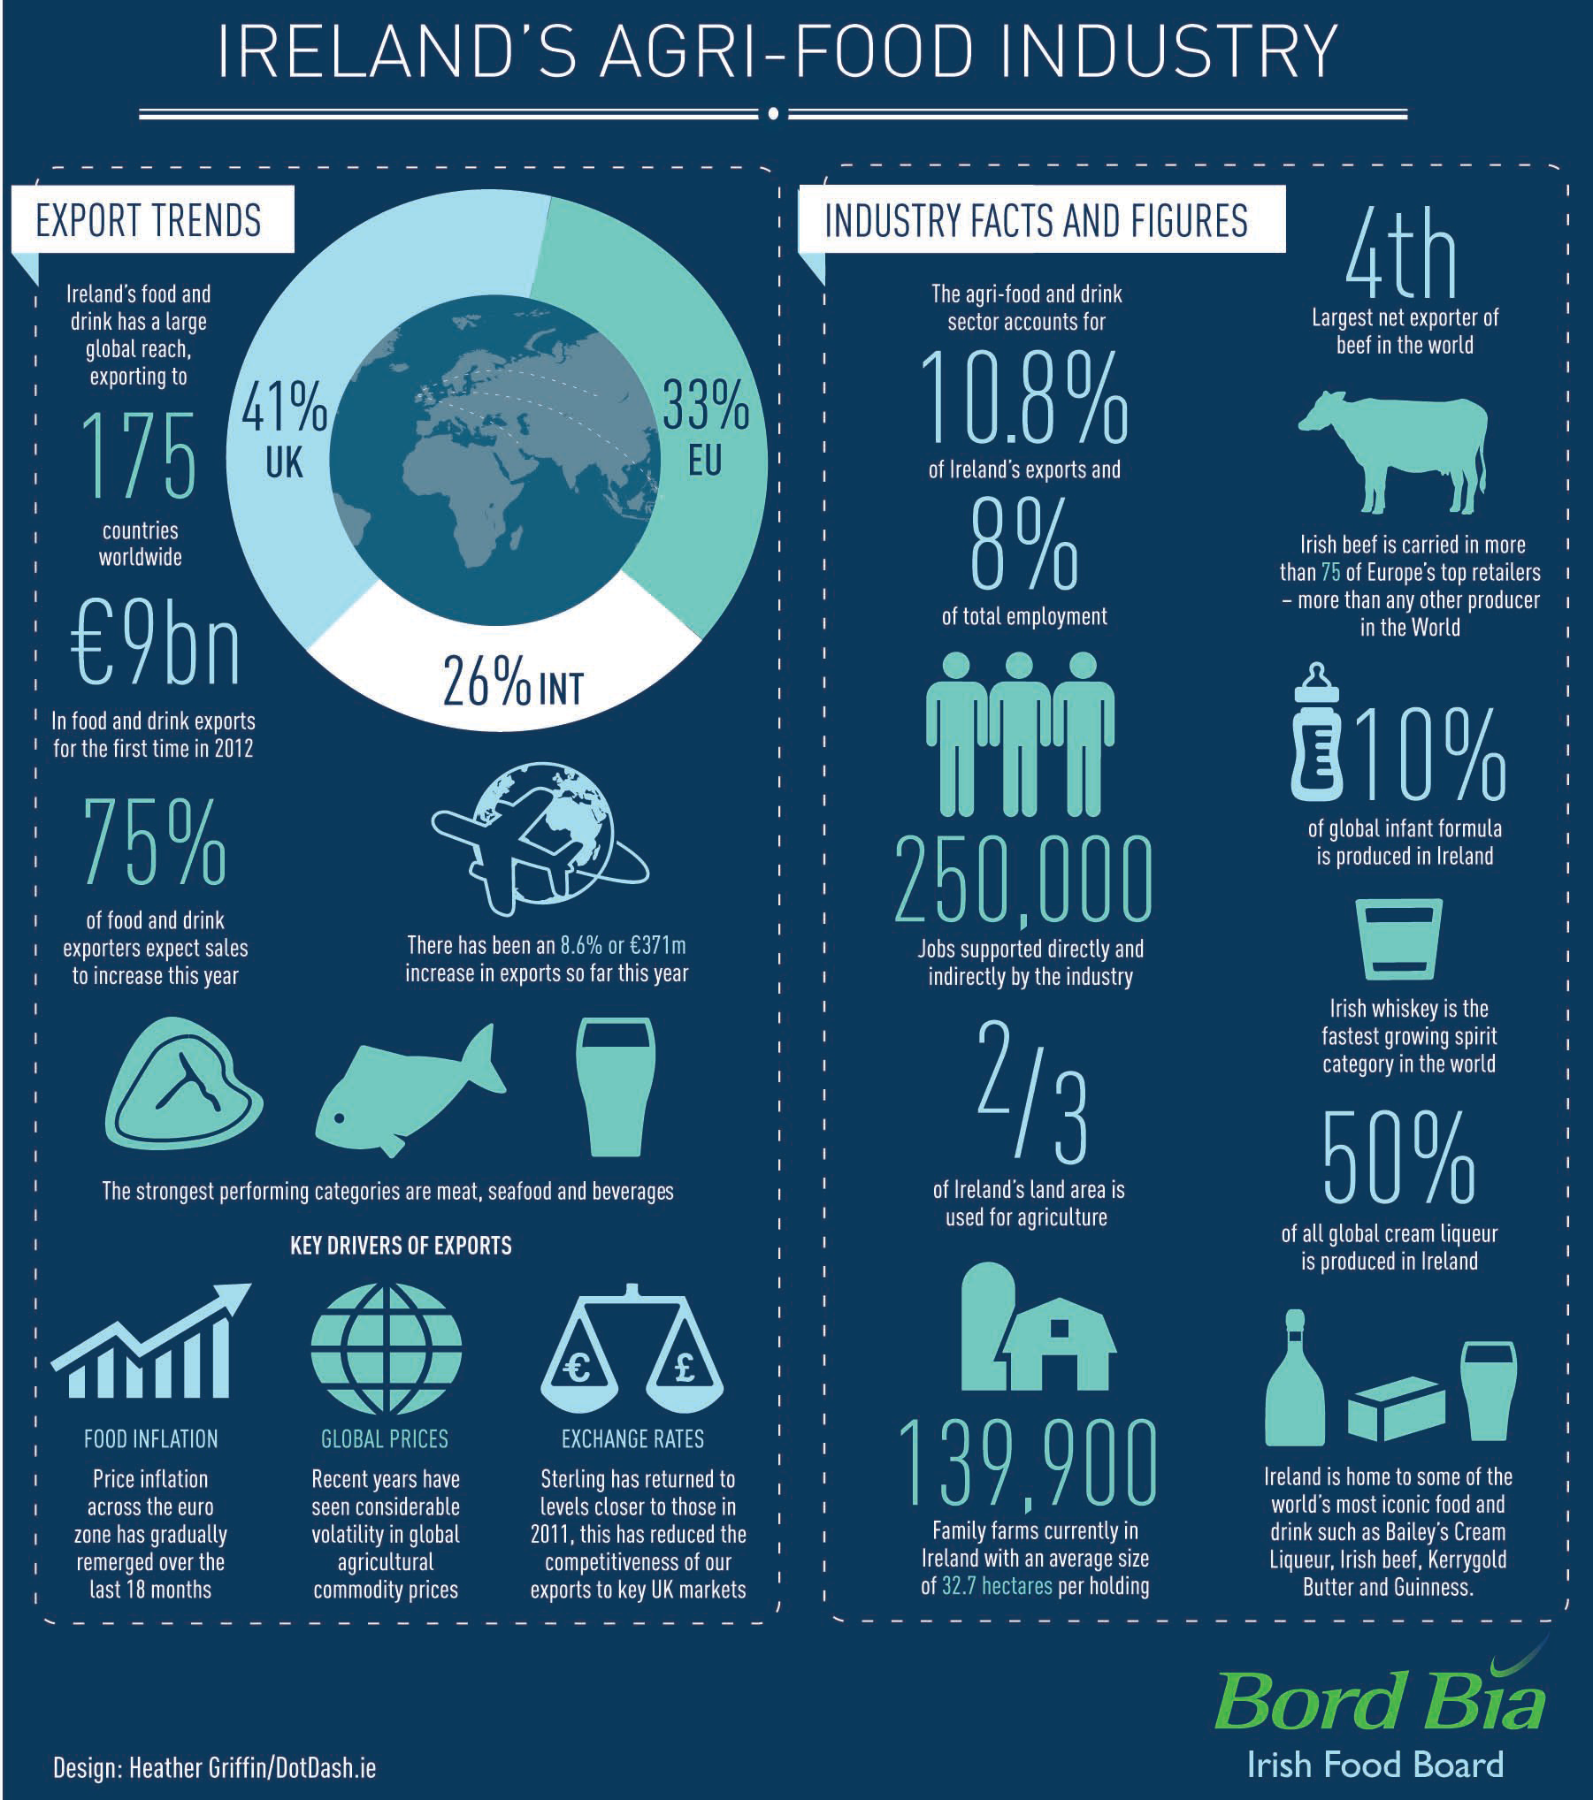

Slide 4
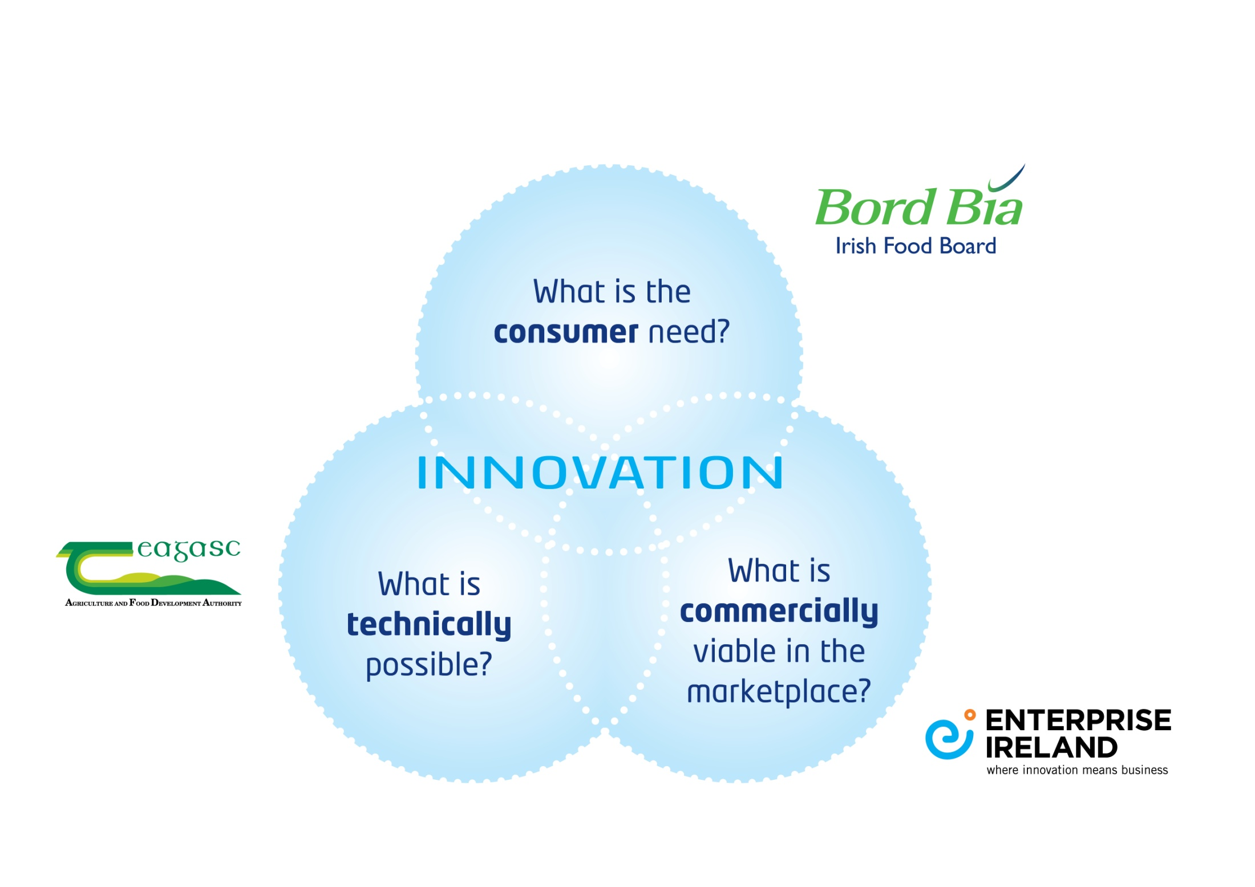
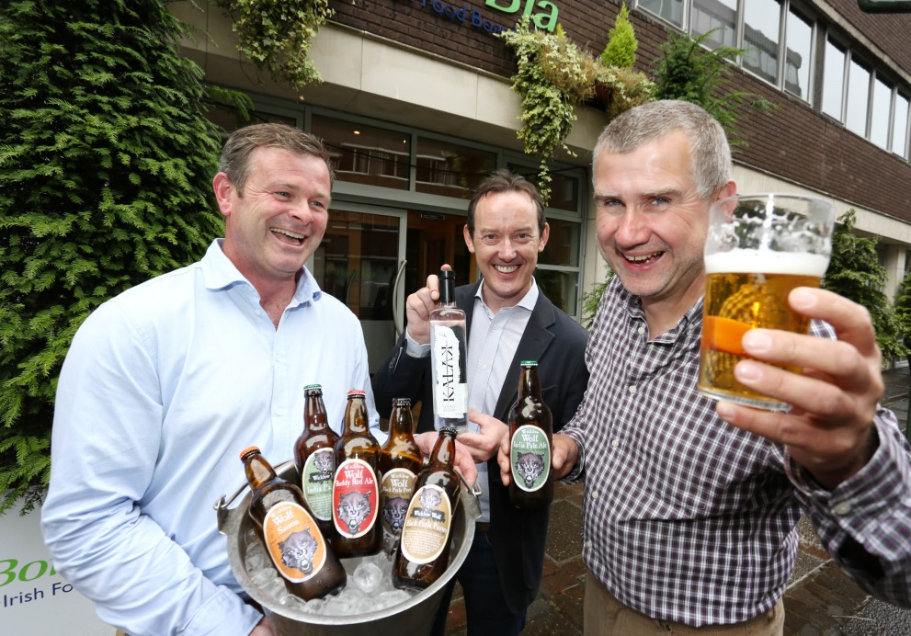
www.foodworksireland.ie

Slide 5

The Food Works Programme

Slide 6


Slide 7

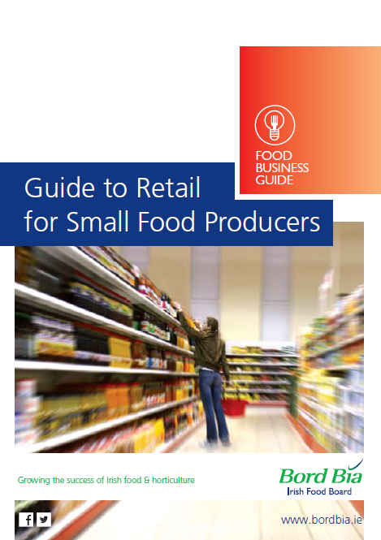

Slide 8





Supplier Development Programmes 2014 – Retail & Foodservice

Slide 9





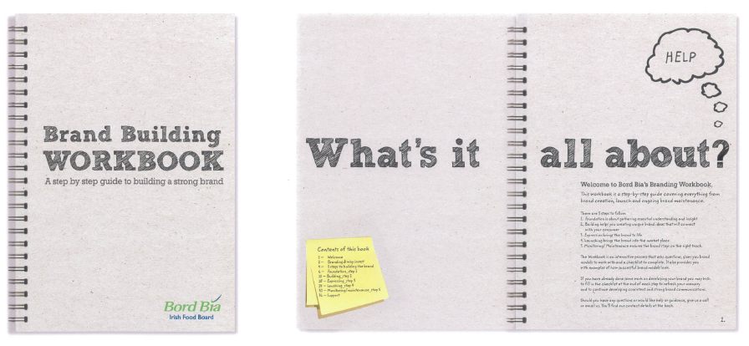
Market Insight & Knowledge
  Category Data and Statistics
  Market Overviews
  Workbooks

Slide 11
Category Research 2014
Chilled
Craft beer
Crisps & Snacks (UK)
Organic consumer study (IRL)
Bakery (IRL/UK)
Jams & Sauces

Slide 12


Insight & Innovation
Small Business Consumer Research
A series of 6 focus groups held for 8 months of the calendar year split between Ireland & UK
Maximum of four companies per wave
Research involves sharing 6 focus groups (4 face to face, 2 online)
Clients receive a full debrief and recommendations
Cost €1,000

Slide 13
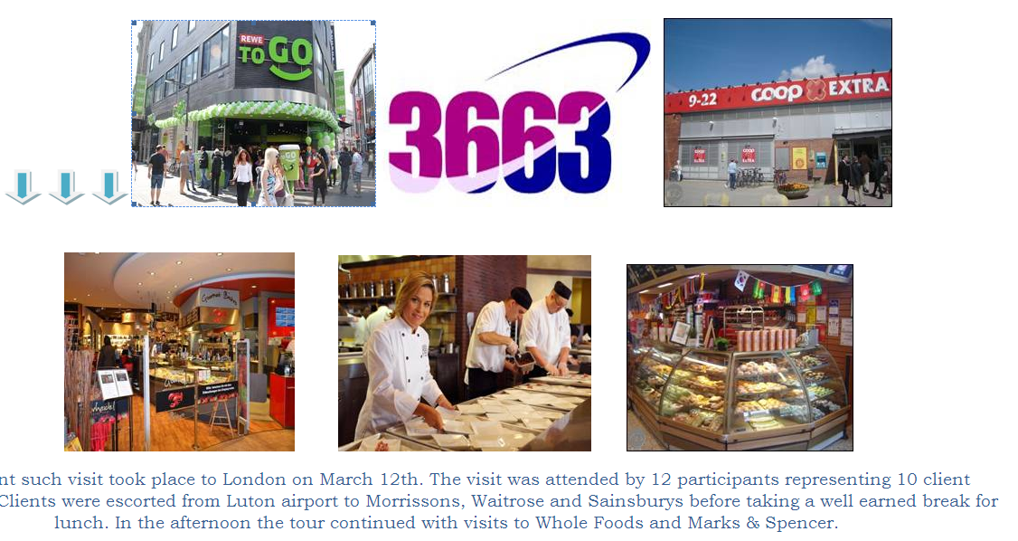
Market Study Visits 2014

Slide 14




Inspiration Expeditions
stimulate creative thinking
motivating and inspiring clients
encouraging companies to uncover and experience the new and re-evaluate what they already know

Slide 15



Marketing Assistance Programme
Eligible for businesses with forecast turnover between €100,000 - €3.5m in the year of application
The programme is open to food, drink and horticulture (edible and amenity) companies
Closing date for applications will be end Feb 2015
186 grants in 2014 totalling €976,000

Slide 16
Marketing Assistance Programme
ELIGIBLE ACTIVITIES
The principal areas for which support is available are:
Trade Fairs and Exhibitions
Marketing, Design and New Product Development
Quality Measures
Aid covers up to 60% of marketing expenditures

Slide 17
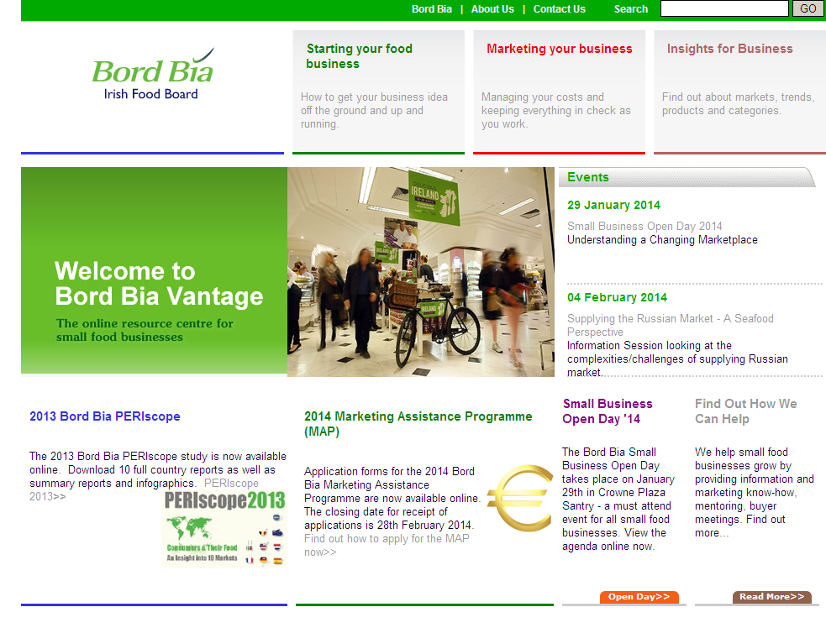
www.bordbiavantage.ie

Slide 18

Vantage Plus – 2014 Themes
Online Marketing – 3rd April
Making the most of PR – 7th May
Distribution to the independent sector - 16th September
Introduction to Export – 16th October

Slide 19




Slide 20
Thank You
Visit: www.bordbiavantage.ie
Email: vantage@bordbia.ie
Join our group on Linkedin: Contact Info@bordbia.ie
Copies of all Bord Bia publications are available on www.bordbia.ie

